Slide 1




It was the best of times, it was the worst of times...

Slide 2
Raymond Camden
Developer Evangelist for HERE
Working on Enterprise Map Demos of Cats
Second best “Just Dance 2019” player (in my house)
Blogging at raymondcamden.com
Tweeting at @raymondcamden

Slide 3

Notes:
I want to start off by telling you a story - a story of how I became a web developer and what that landscape was like
i'll warn you ahead of time that I reserve the right to make up facts when i think it will make things more interesting so take what
follows with a small grain of salt

Slide 4
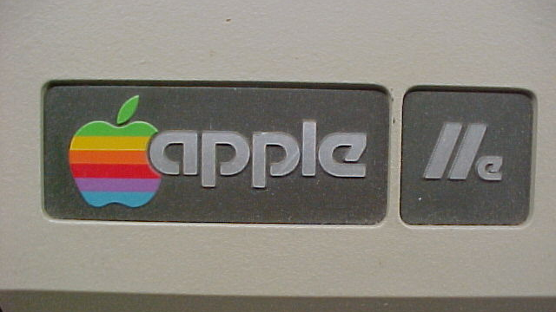

Slide 5


Slide 6


Slide 7


Slide 8
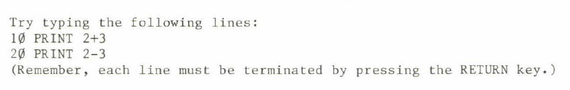

Slide 10
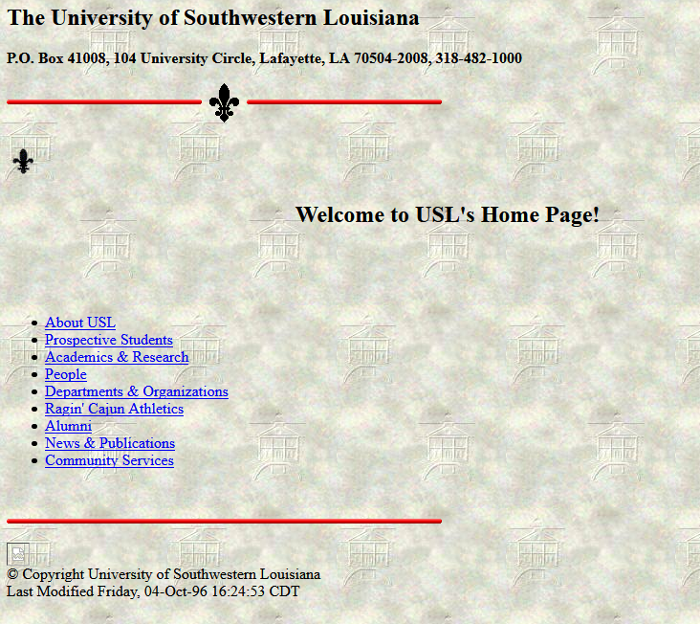
Notes:
i started my web career around 93 or so while at college - this is the oldest version of my college's web site that i could find and even this one is a good year and a half after i graduated. i can say at that time my primary browser was mosaic although id use Lynx from time to ime

Slide 11
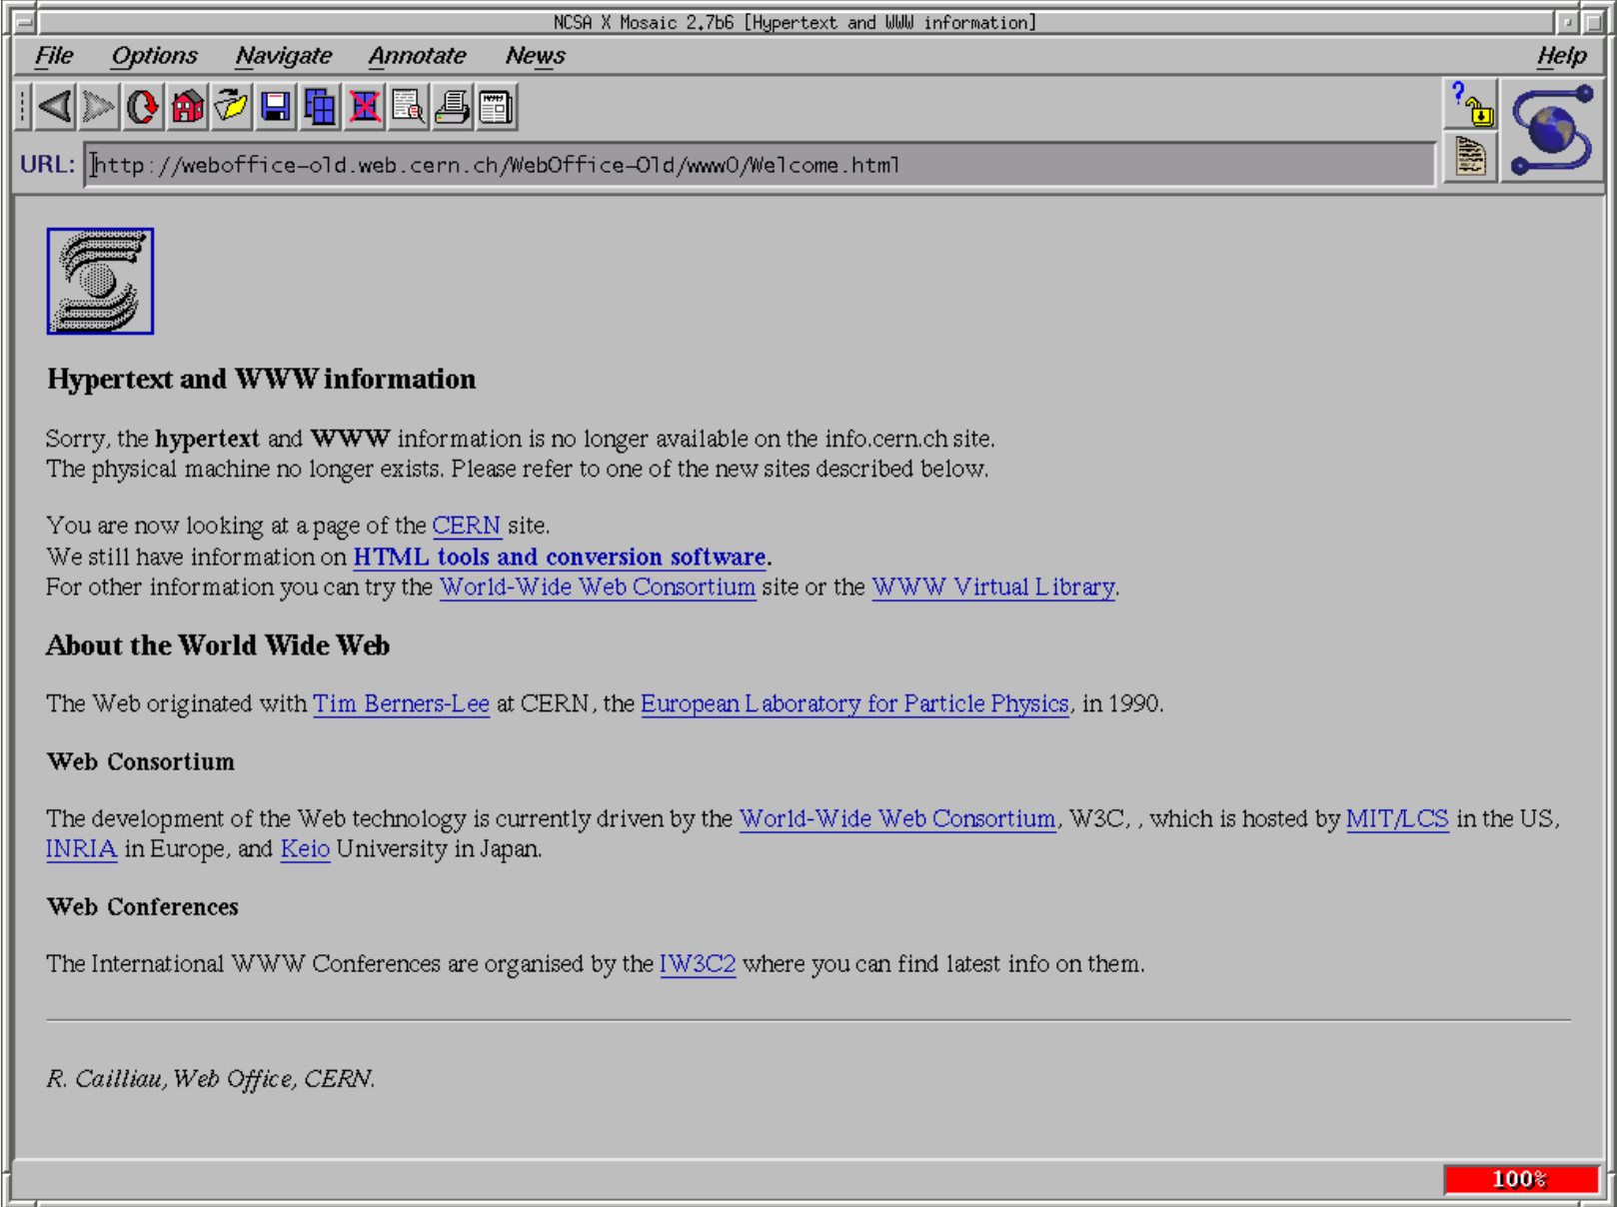
Notes:
http://www.desy.de/web/mosaic/d2-annotate-menu.html

Slide 12
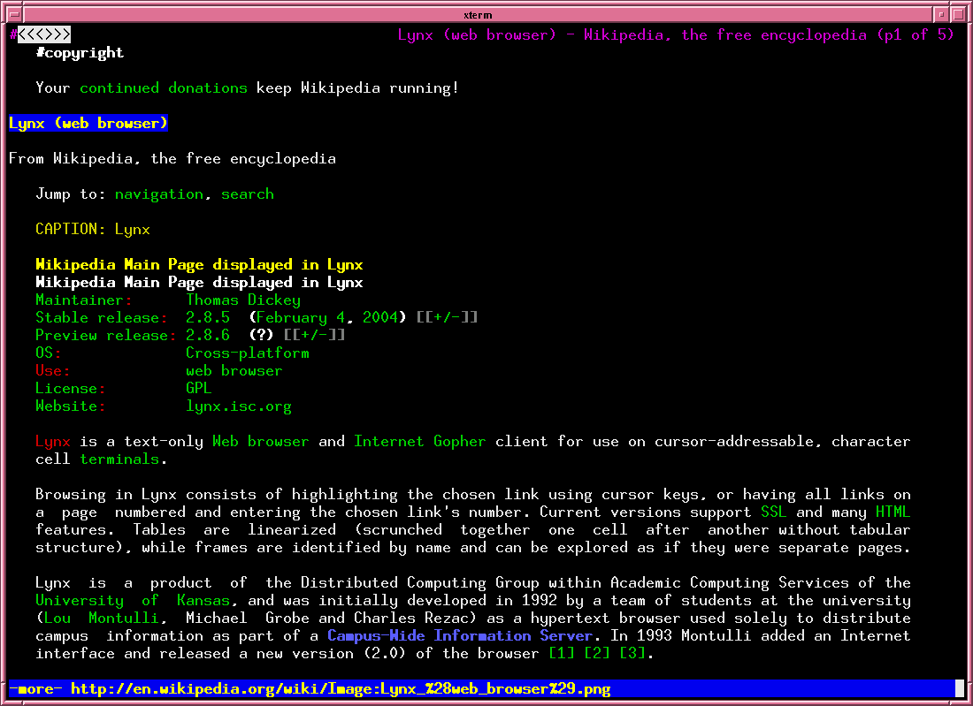

Slide 13
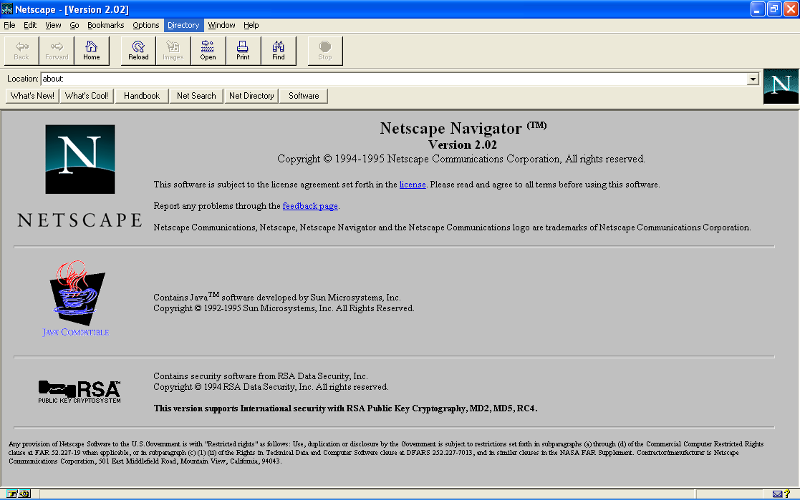
Notes:
my first introduction to javascript
officially called LiveScript when it first shipped in beta releases of Netscape Navigator 2.0 in September 1995

Slide 14
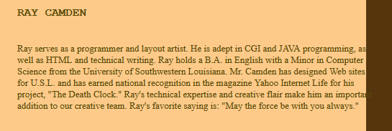
Notes:
two HUGE lies - i knew jack about Java and "layout artist"

Slide 15


Slide 16

Imagine a random IE meme here because frankly there's more than enough blame to go around for crap on the web...

Slide 17

Notes:
i gave up - retreated to the back end
worked with photoshop slices and HTML template
i did this for years, any JS i used was form validation, or calling focus on an input field

Slide 18

Notes:
COOKIE STORY OF DOOM

Slide 19
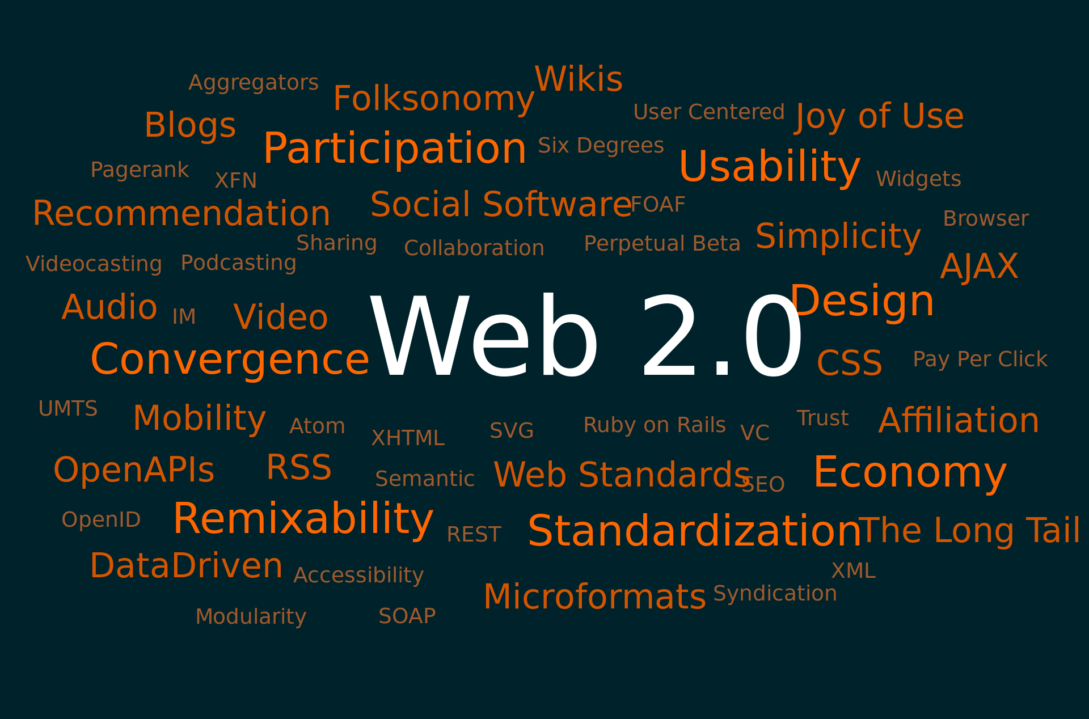
Notes:
web 2.0 (actually 2002 or so)
i started getting interested again

Slide 20
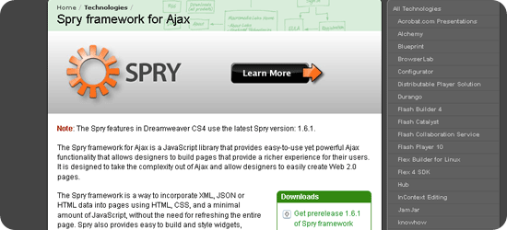

Slide 21
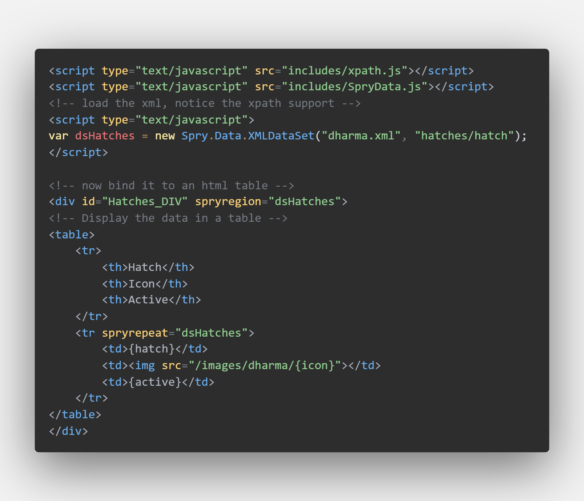

Slide 22

Notes:
html5 came around and it was awesome

Slide 23

Notes:
everything was perfect - everything was awesome
make a dig at Safari

Slide 24


Slide 25

Hi! Instead of actually reading the content that brought you here, wouldn't you rather subscribe to my email list instead?
YES!!!!!!
No, I hate kittens

Slide 26

z
Except...

Slide 27
What if I want to know…
What does my browser support in terms of HTML tags?
What does my browser support in terms of CSS?
What does my browser support in terms of JavaScript syntax?
What does my browser support in terms of APIs?
How does my browser behave in particular situations?

Slide 28
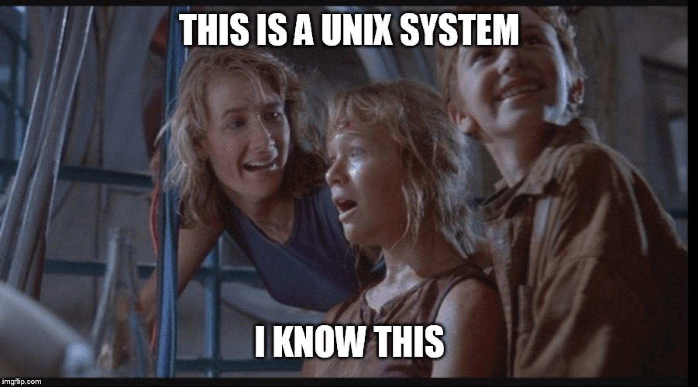

Even more what if?
Developer side
Consumer side

Slide 29
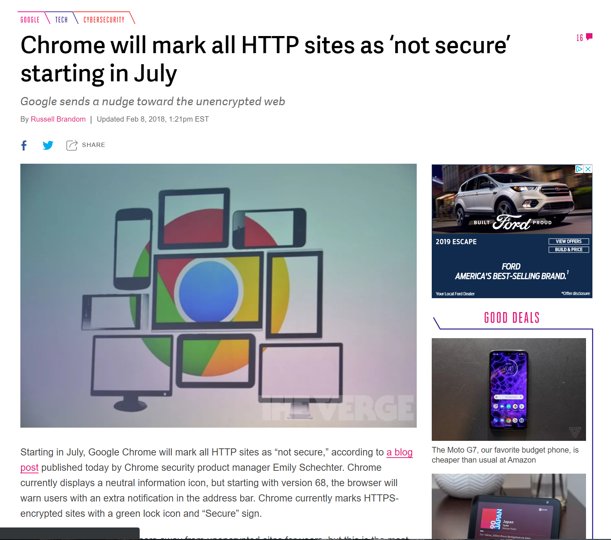
Notes:
only one example
geolocation requiring a prompt, not working in localhost

Slide 30
Geolocation (as an example)
It just worked
Then it required a prompt
Then it stopped working on http (except localhost)
Notes:
I'm not saying this is wrong, or a problem. This feels like a natural evolution of a feature.
The problem is - how do we figure this out?

Slide 31
My Assumption...
Every browser vendor has a simple to find location that tells me every aspect of it's platform in an easy to read format that clearly specifies when things changed

Slide 32
The reality...
No

Slide 33
My Test
What changed in this version of the browser?
Can I use the <foo> tag?
How many cookies can I store per site?

Slide 34


Slide 35


Slide 36
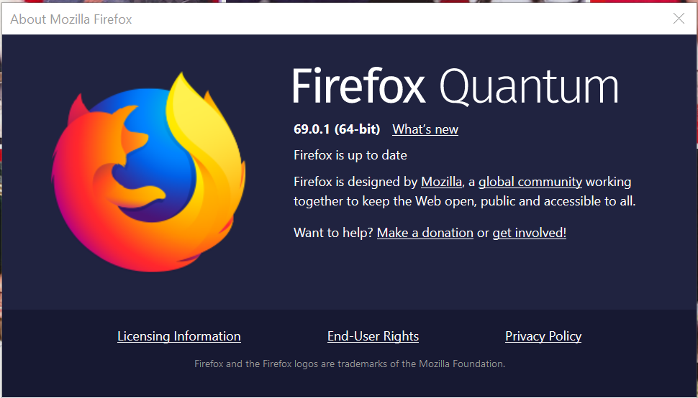
Notes:
Consumer + Developer

Slide 37
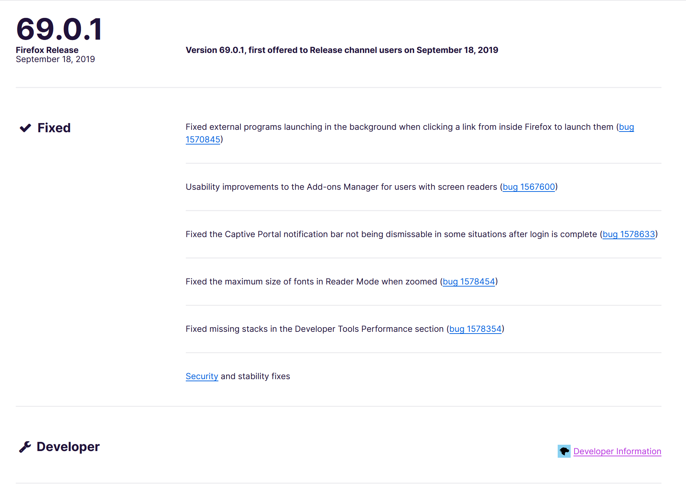

Slide 38
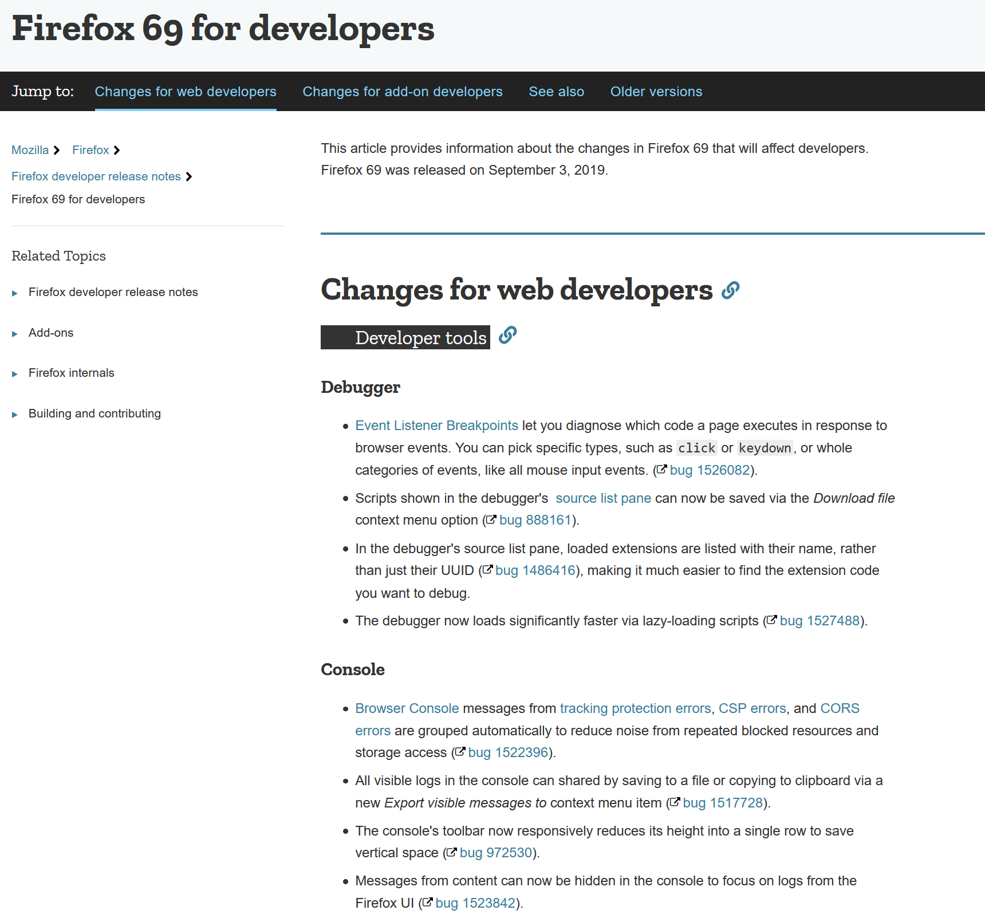

Slide 39
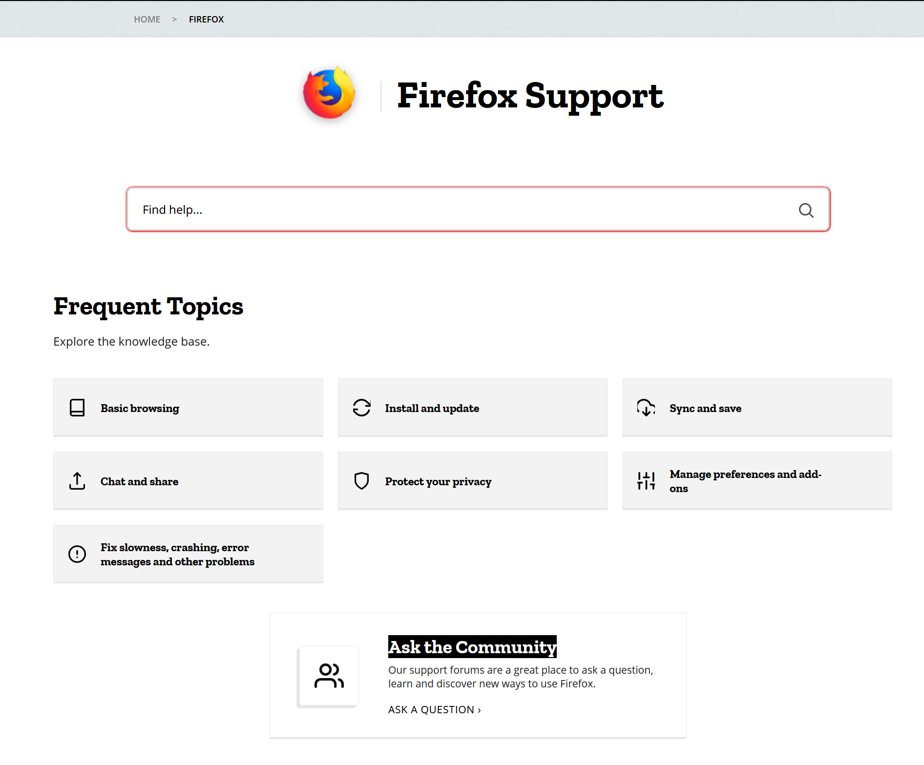
Notes:
I then went to help, and it's 100% consumer, no dev help
I tried - and failed to find a rotue

Slide 40
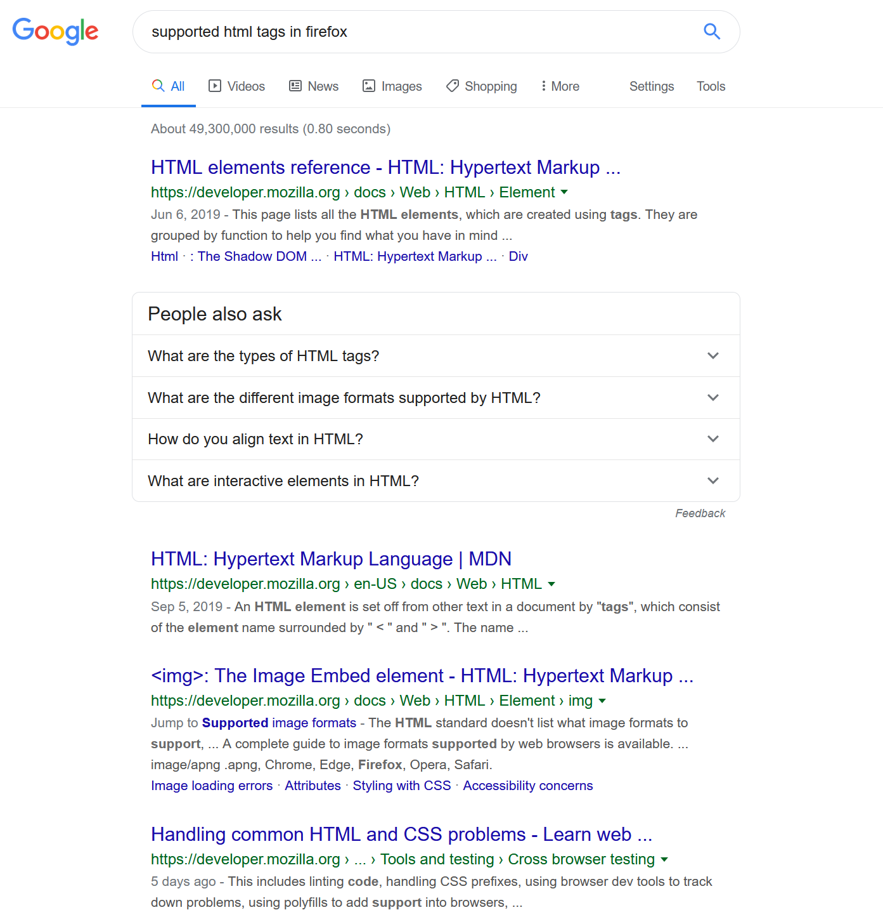

Slide 41
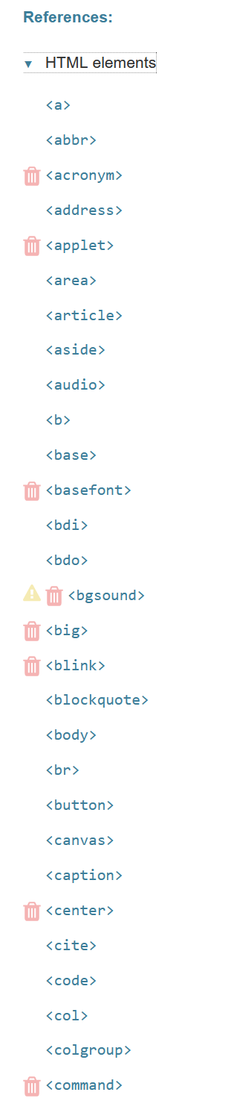

Slide 42
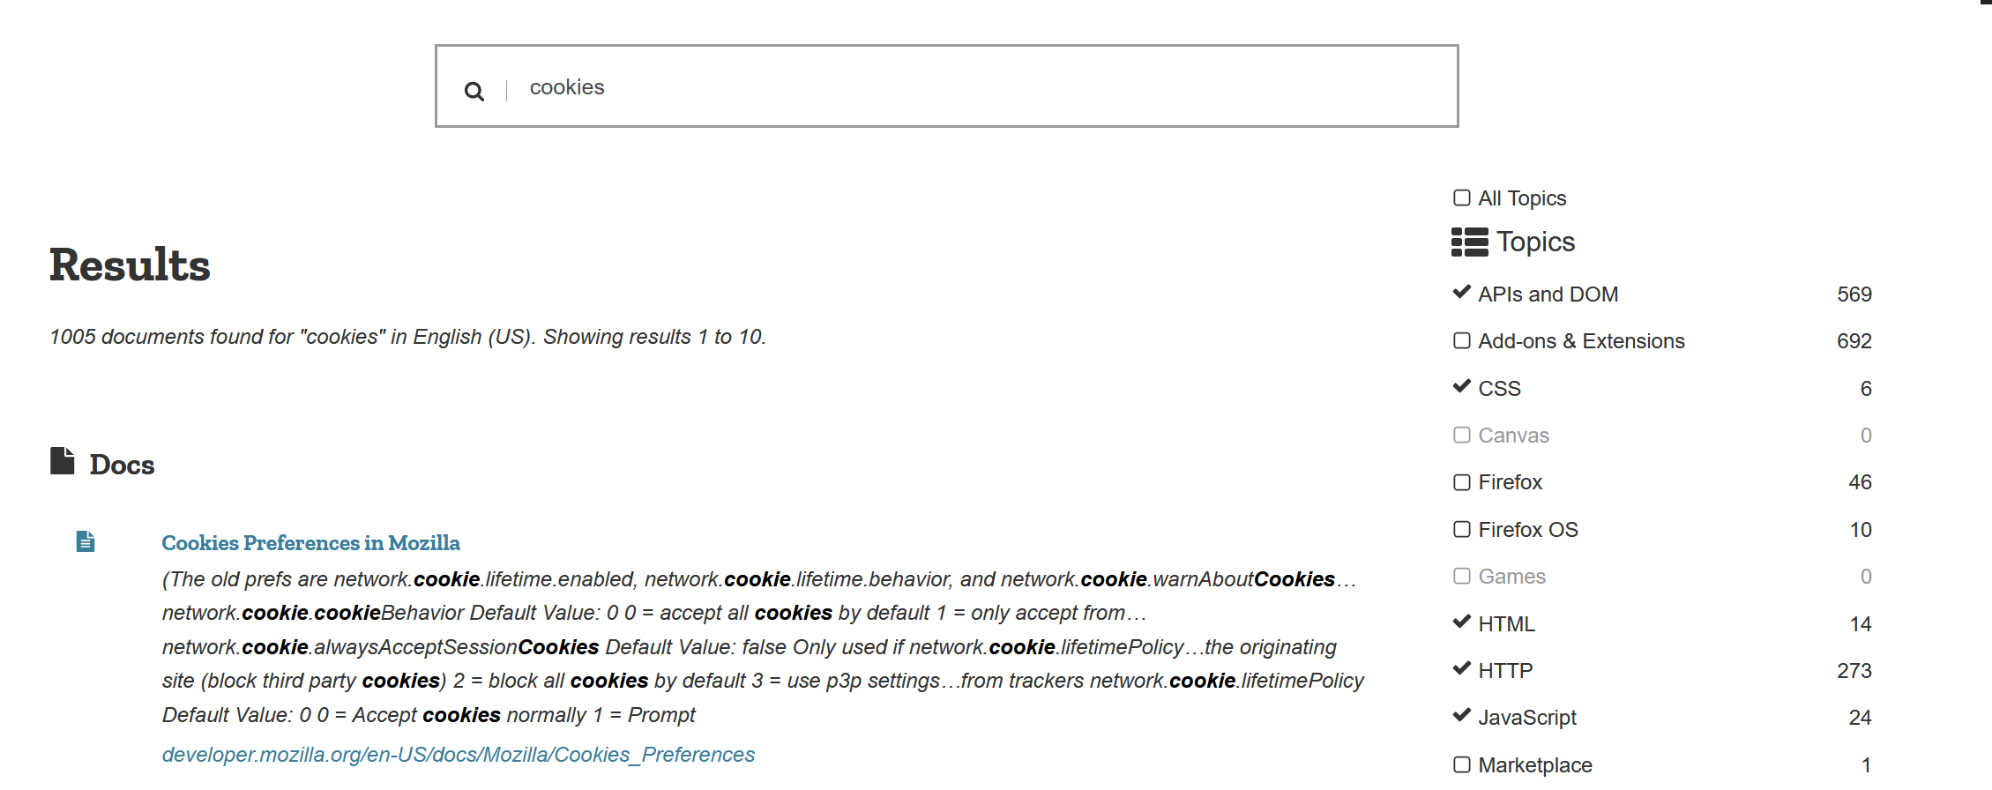
Notes:
still on developer.mozilla.org

Slide 43
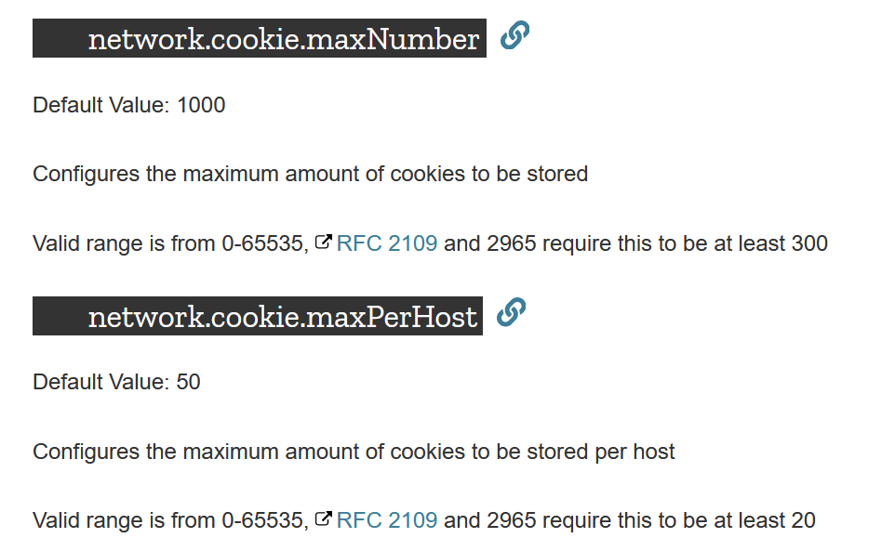

Slide 44
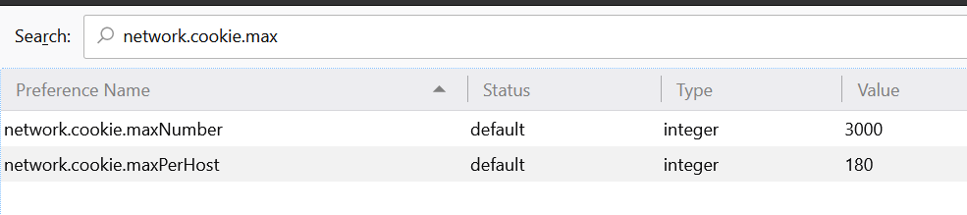
Notes:
about:config

Slide 45


Slide 46
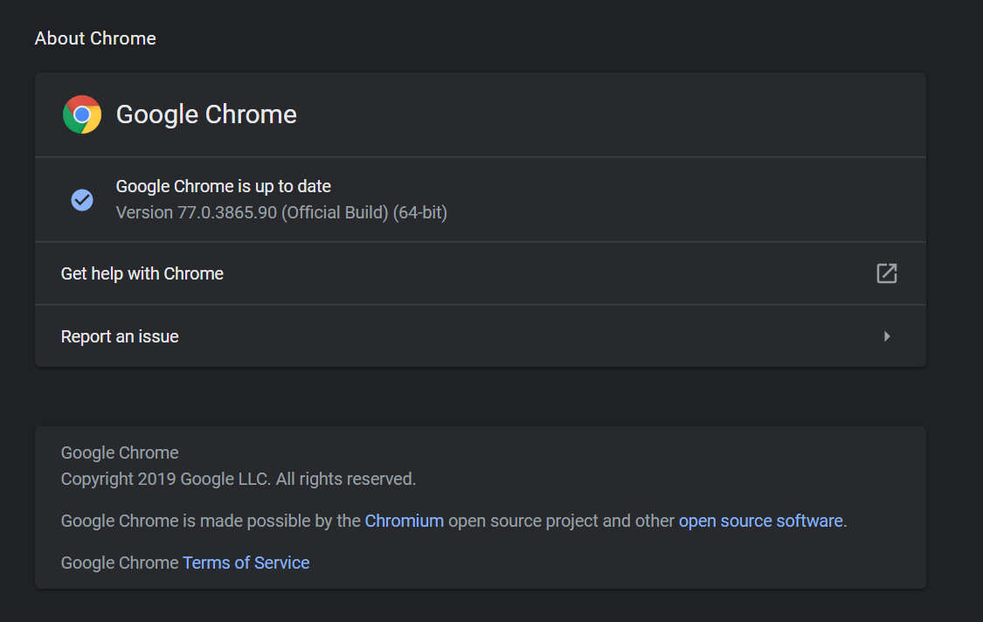
Notes:
"Get help with Chrome"

Slide 47
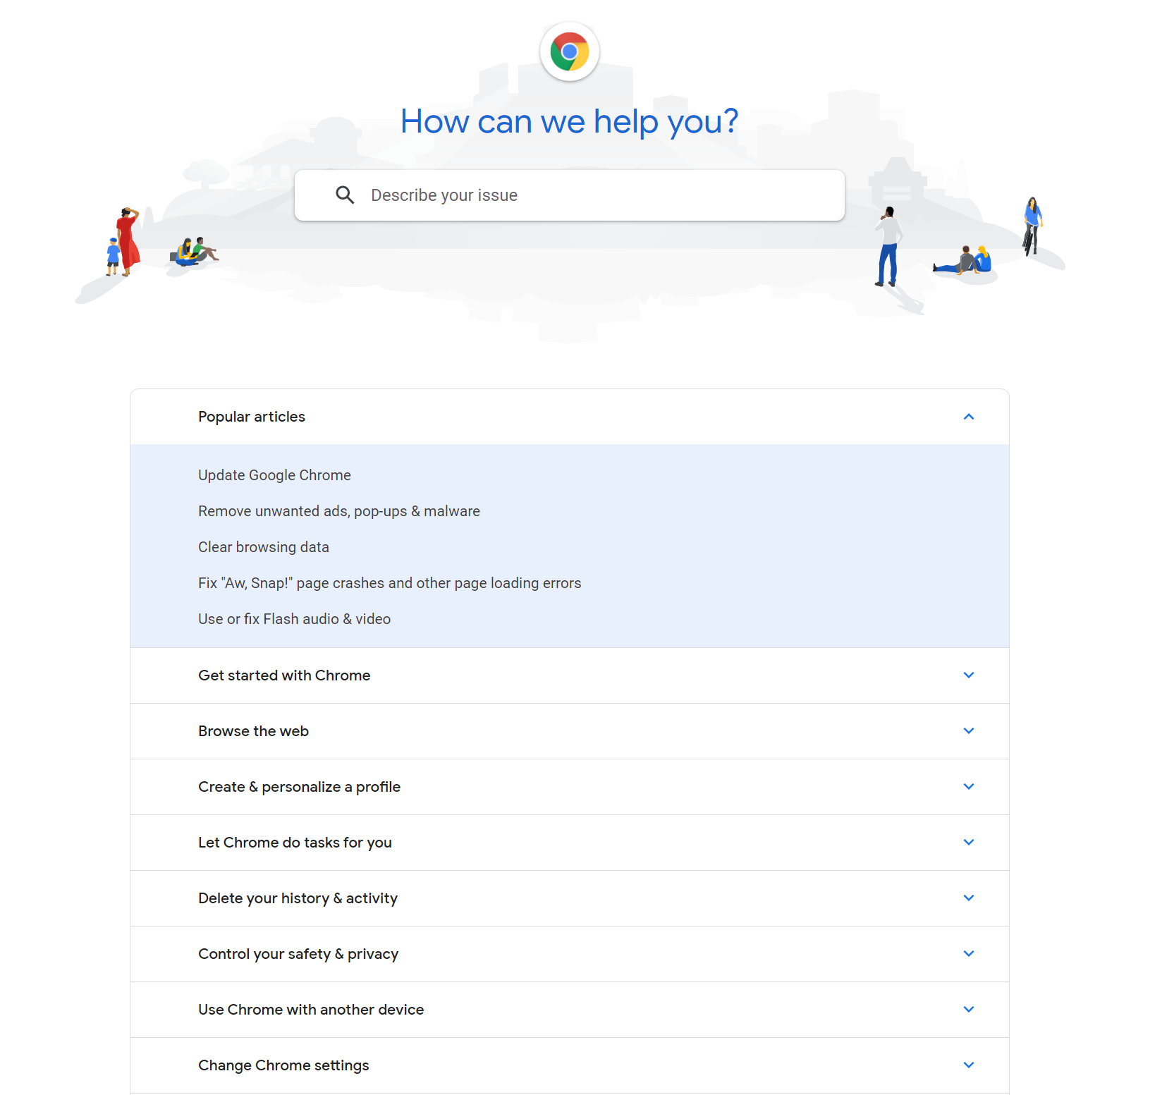
Notes:
again, consumer info only

Slide 48
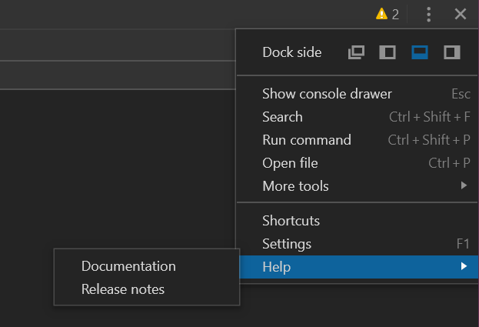
Notes:
If you open dev tools - which means you know it exists - and go to Help there (honestly didn't know about this till about 2 years ago)

Slide 49


Slide 50
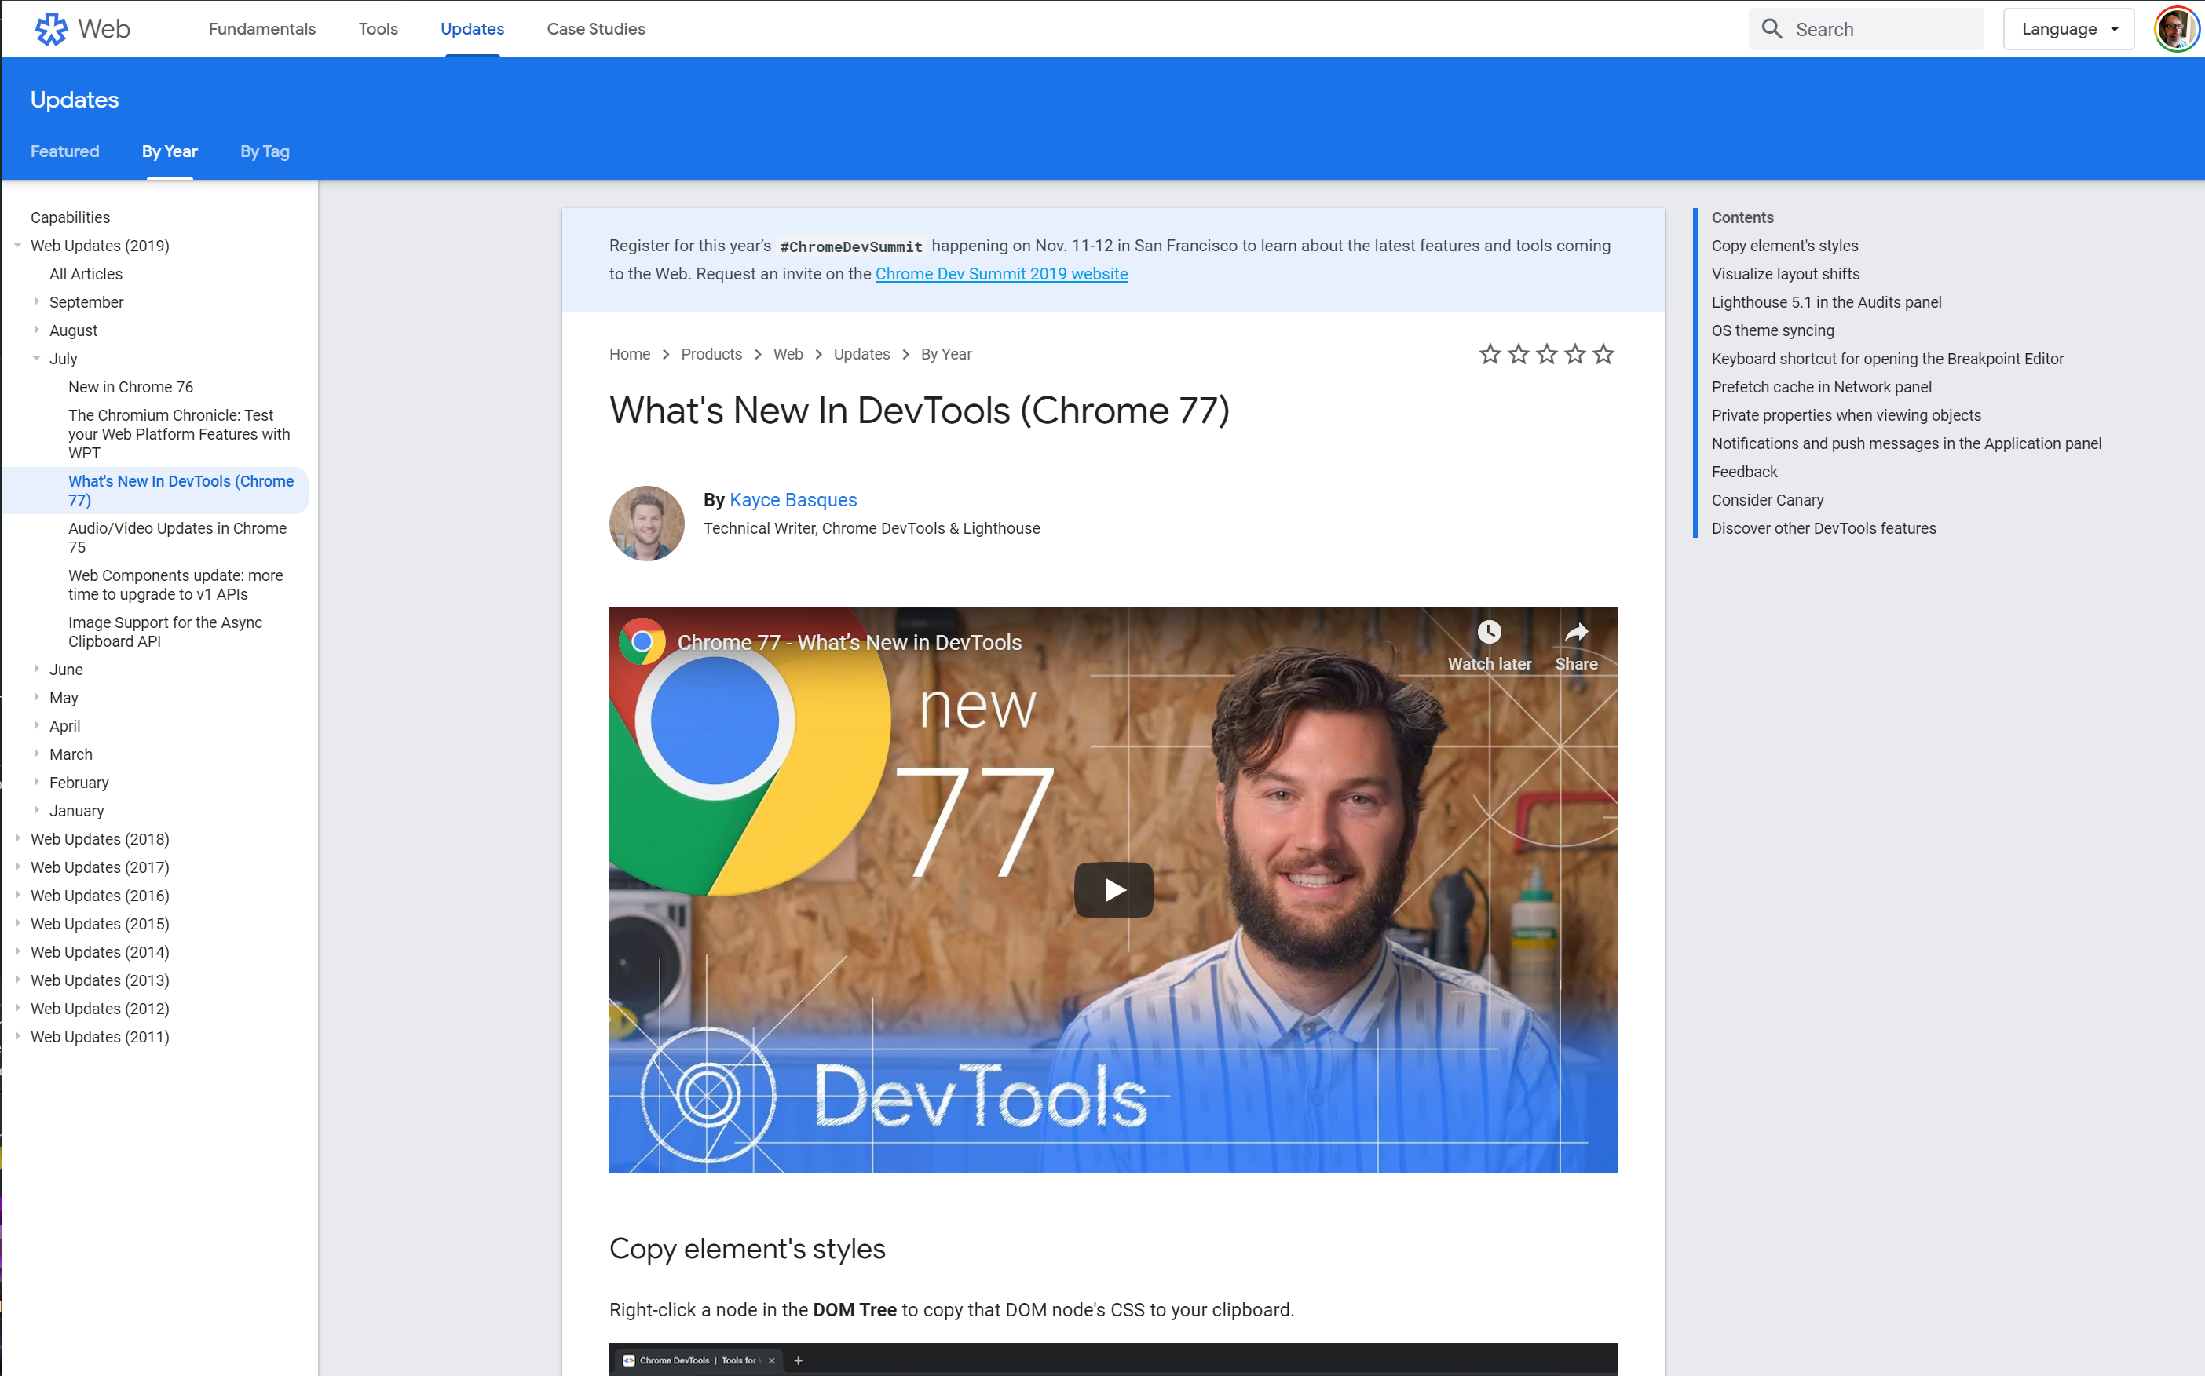
Notes:
No date (although month year in URL)

Slide 51
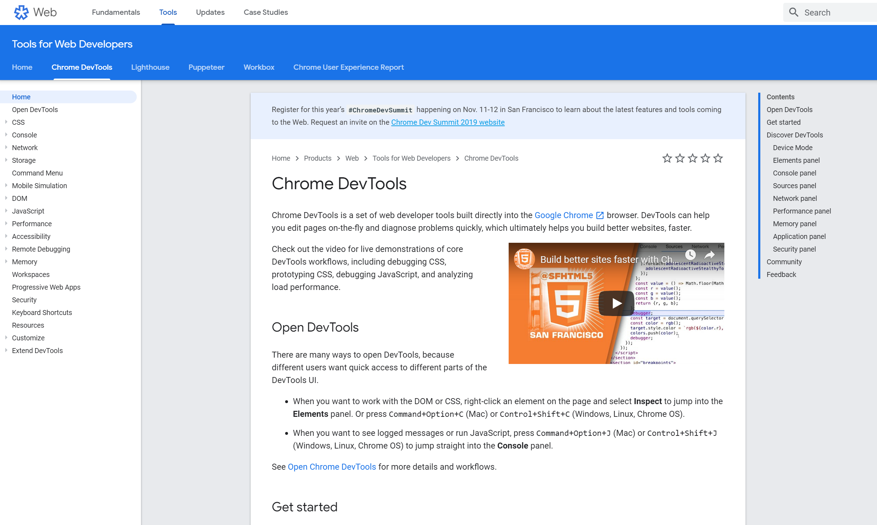

Slide 52
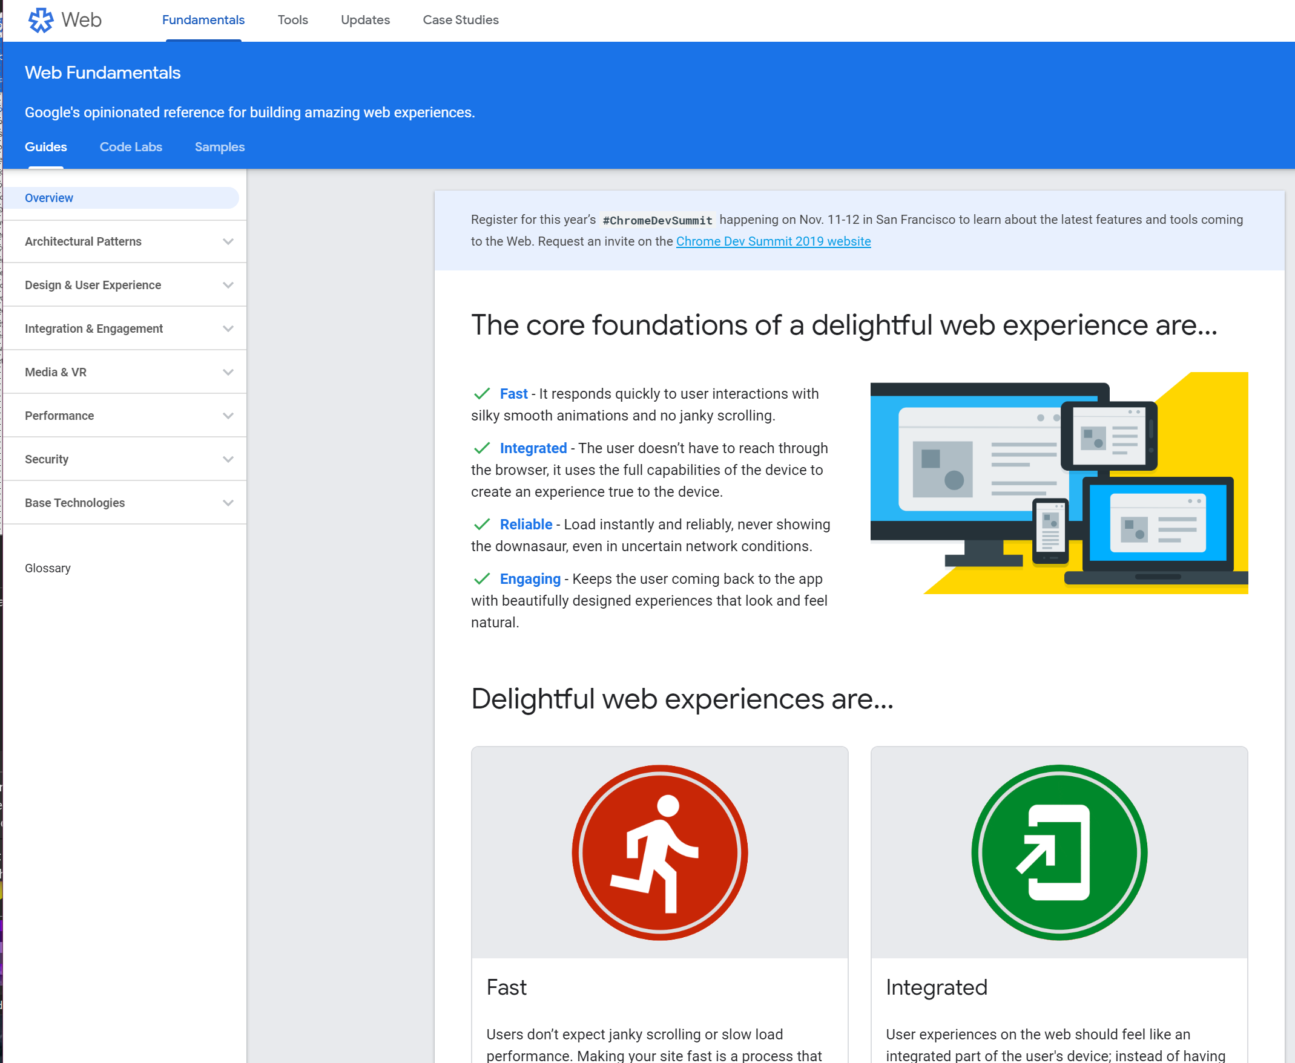
Notes:
architectural patters... and it's app shell

Slide 53
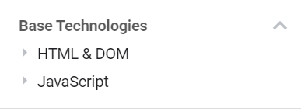

Slide 54
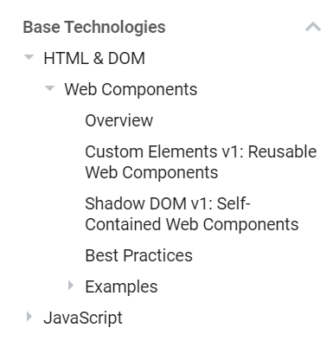
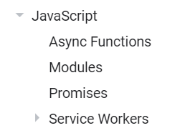

Slide 55
HTML Reference?
Notes:
Tweeted a few times

Slide 56
Cookies?

Slide 57
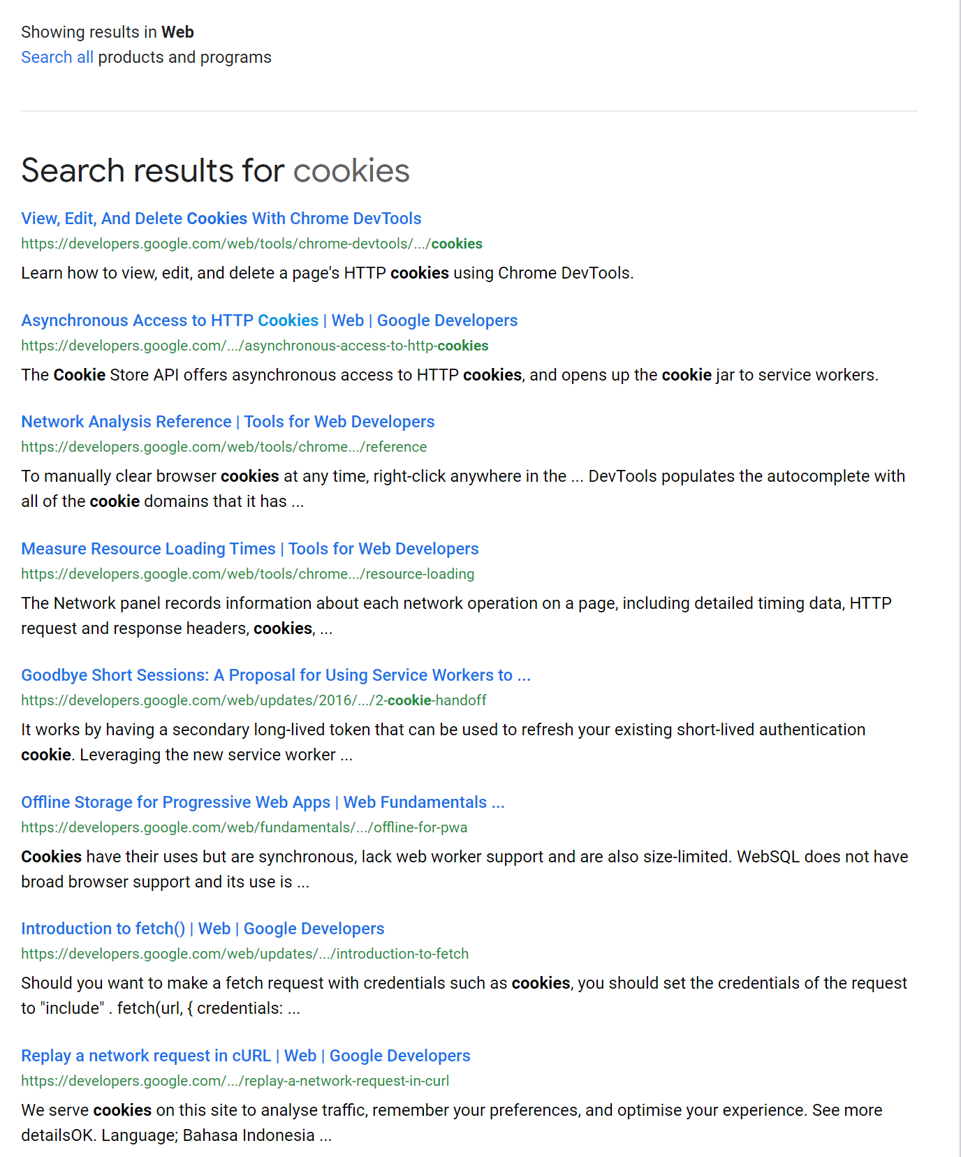

Slide 58
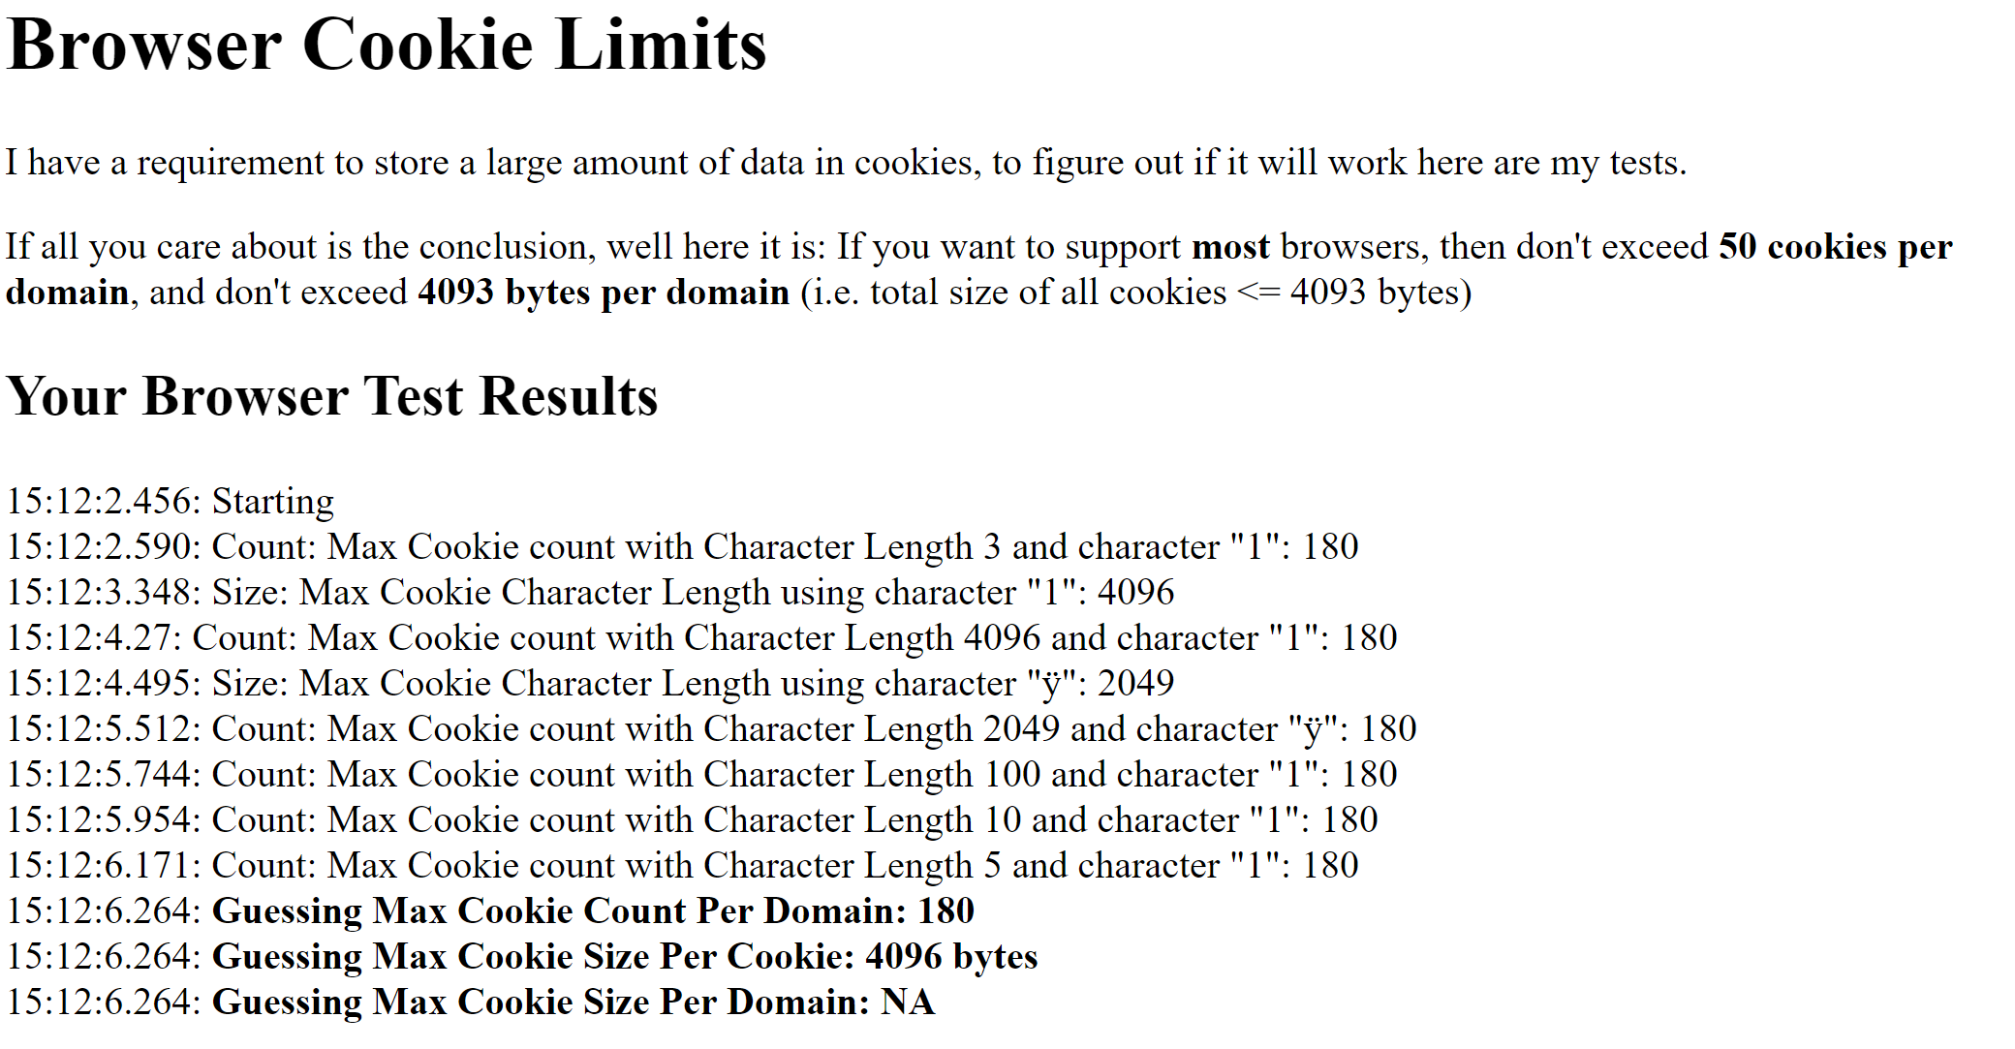
http://browsercookielimits.squawky.net/

Slide 59
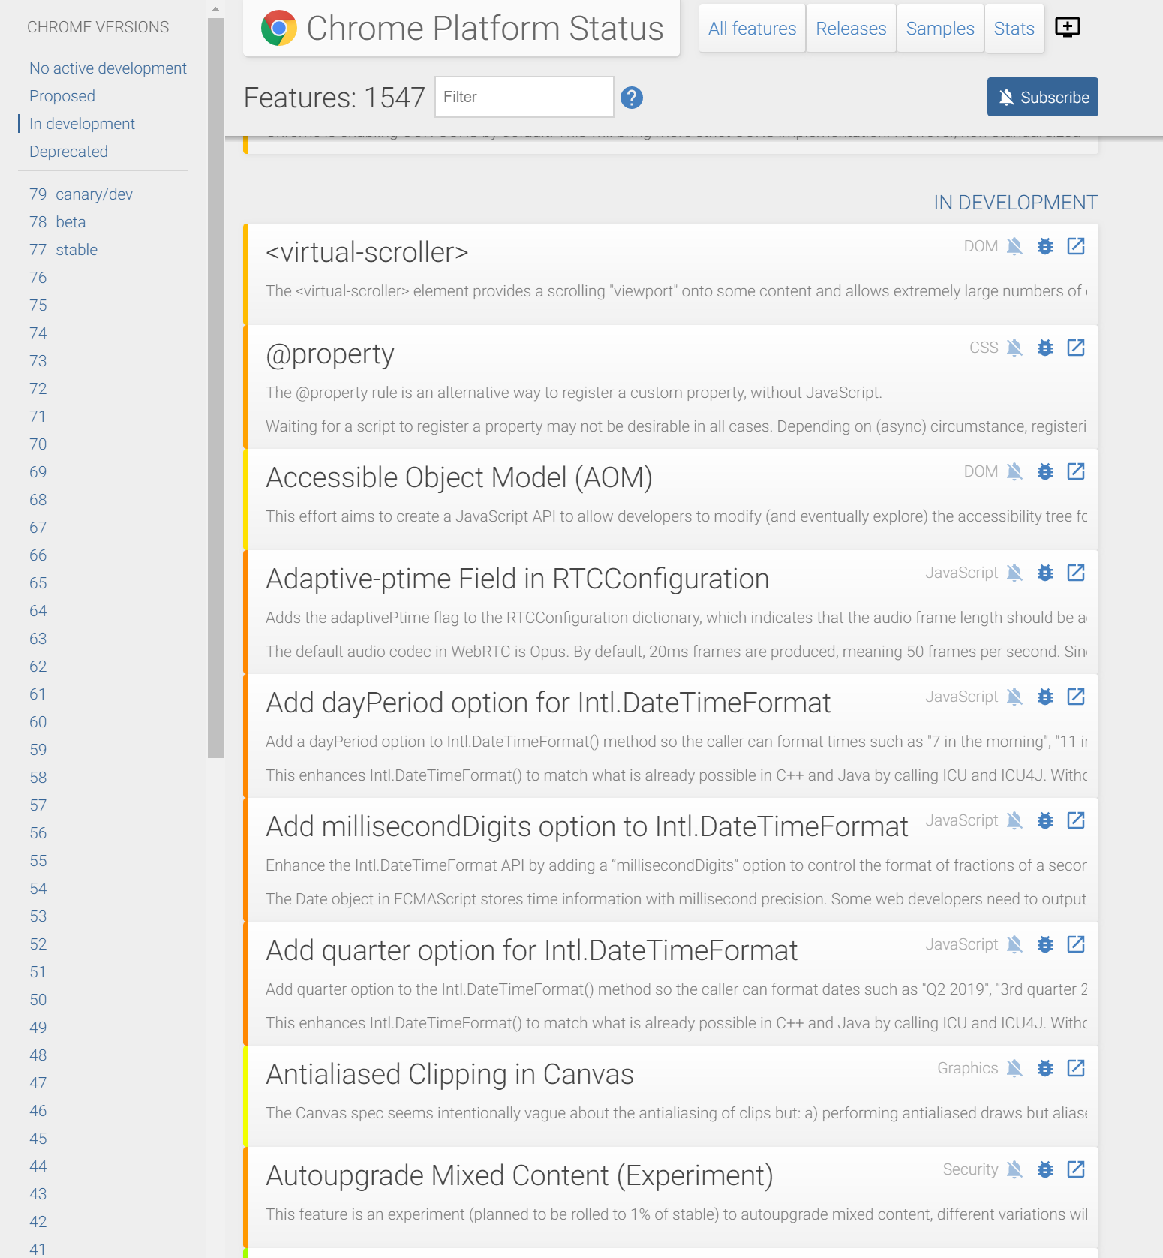
https://www.chromestatus.com/features

Slide 60


Slide 61
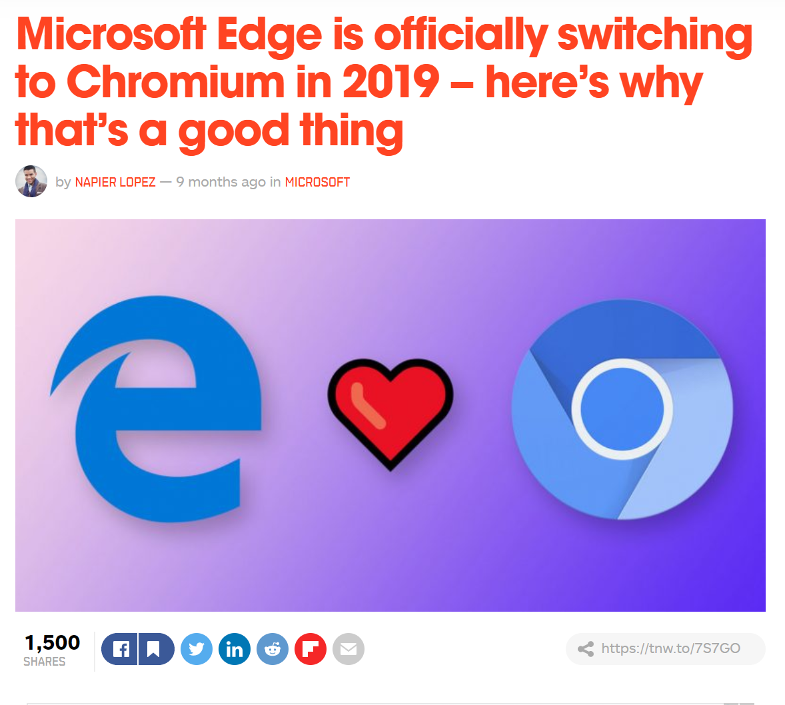
Notes:
i asked on twitter about the timeline - short answer is - not yet

Slide 62


Slide 63
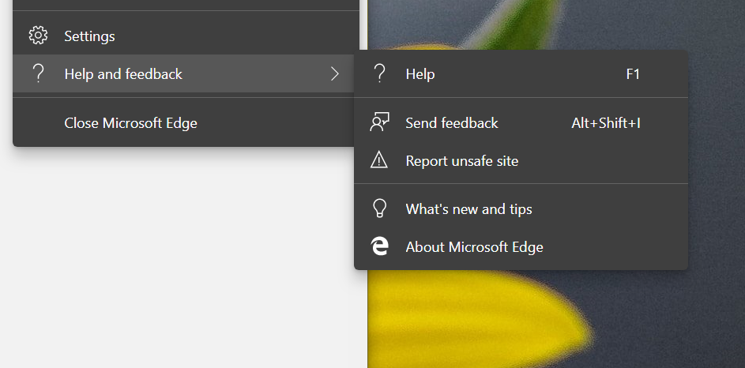
Notes:
THeir about page is as bare as Chrome's is

Slide 64
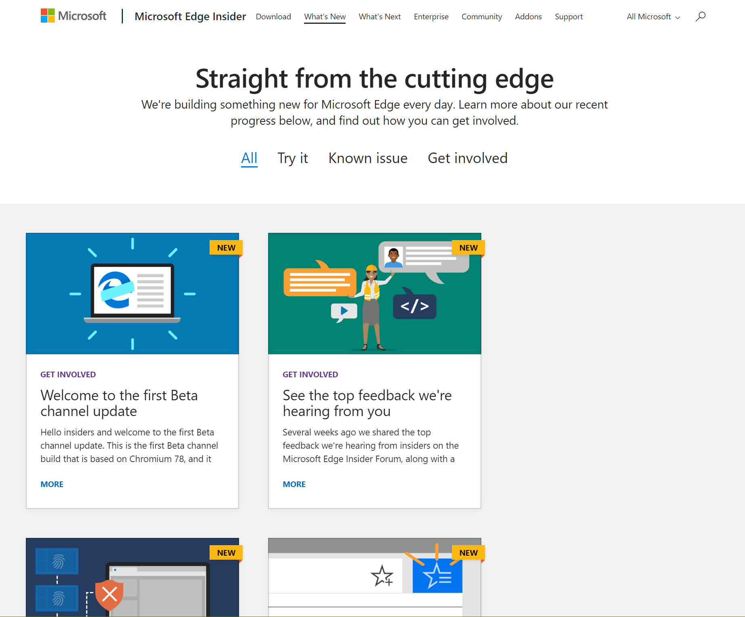

Slide 65
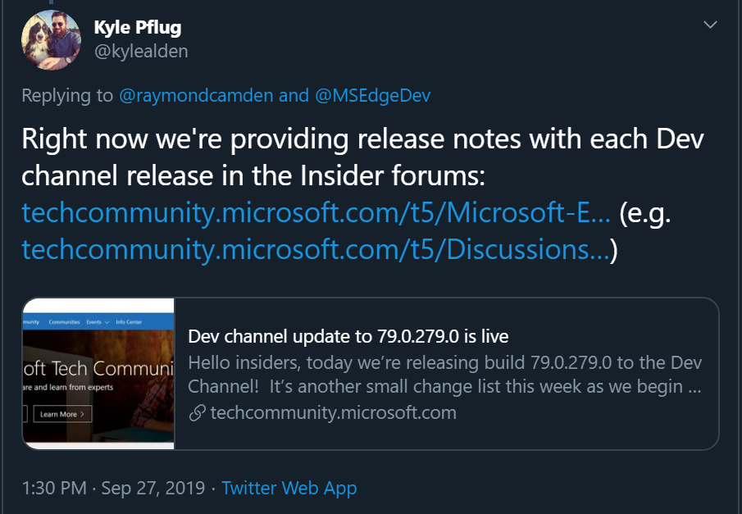
Notes:
https://twitter.com/kylealden/status/1177651847533752320

Slide 66

Notes:
Safari, AKA the browser you need to watch Apple Keynotes.

Slide 67
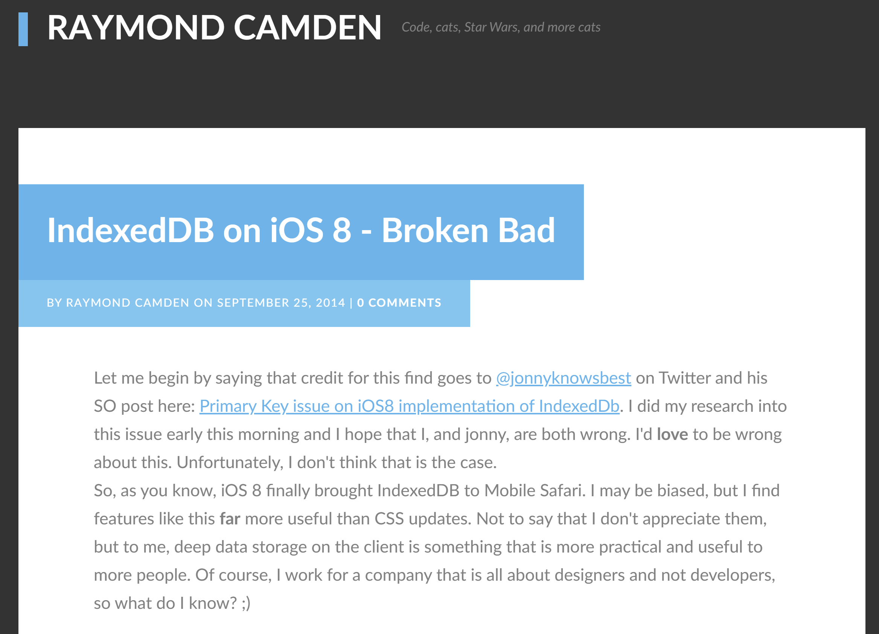

Slide 68
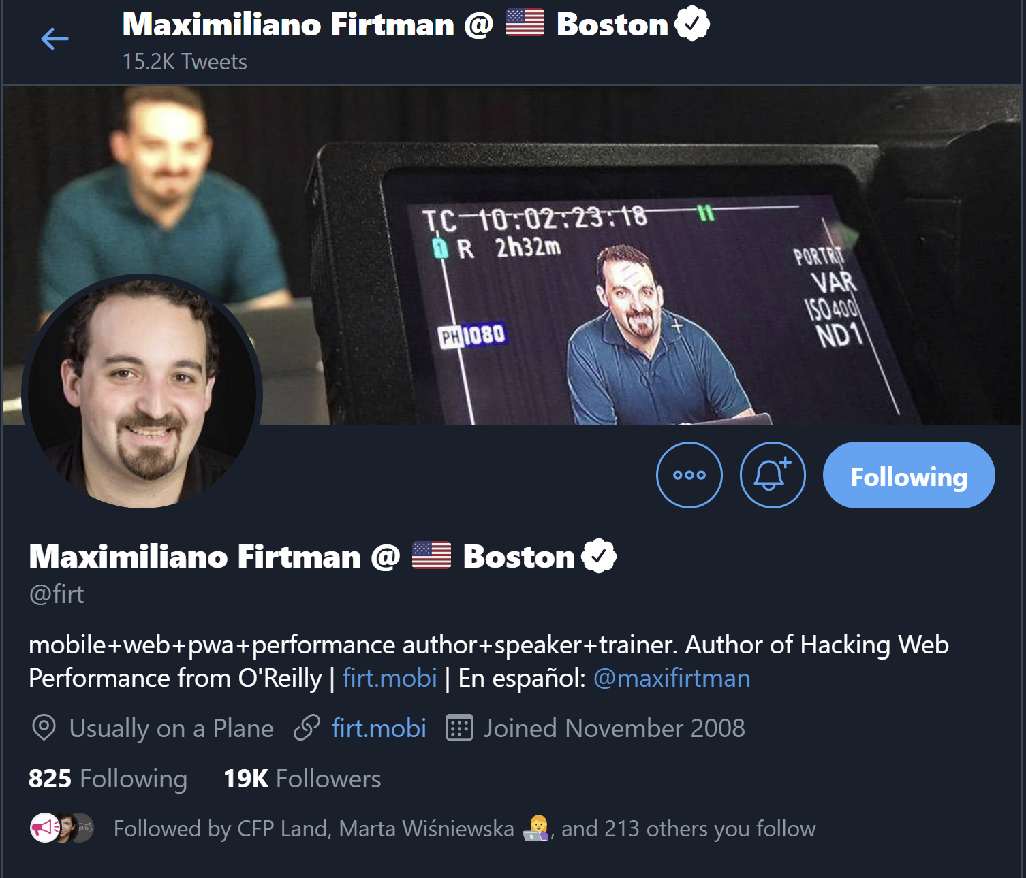
@firt

Slide 69
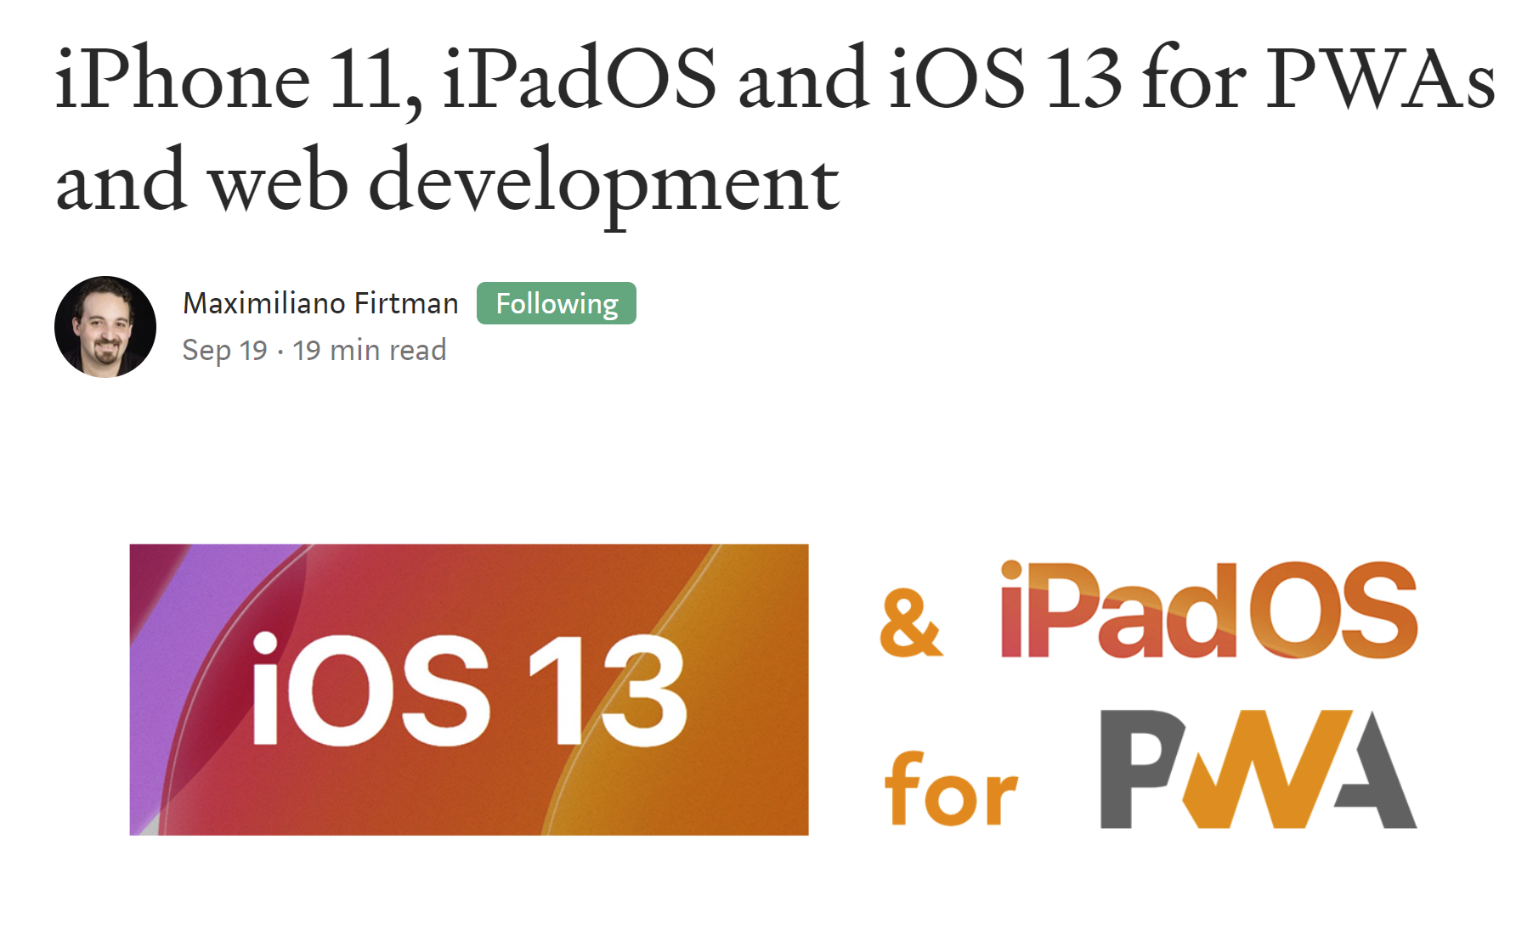
https://medium.com/@firt/iphone-11-ipados-and-ios-13-for-pwas-and-web-development-5d5d9071cc49

Slide 70
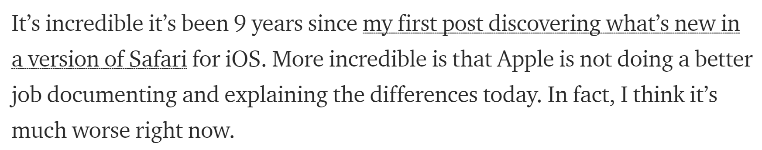

Slide 71
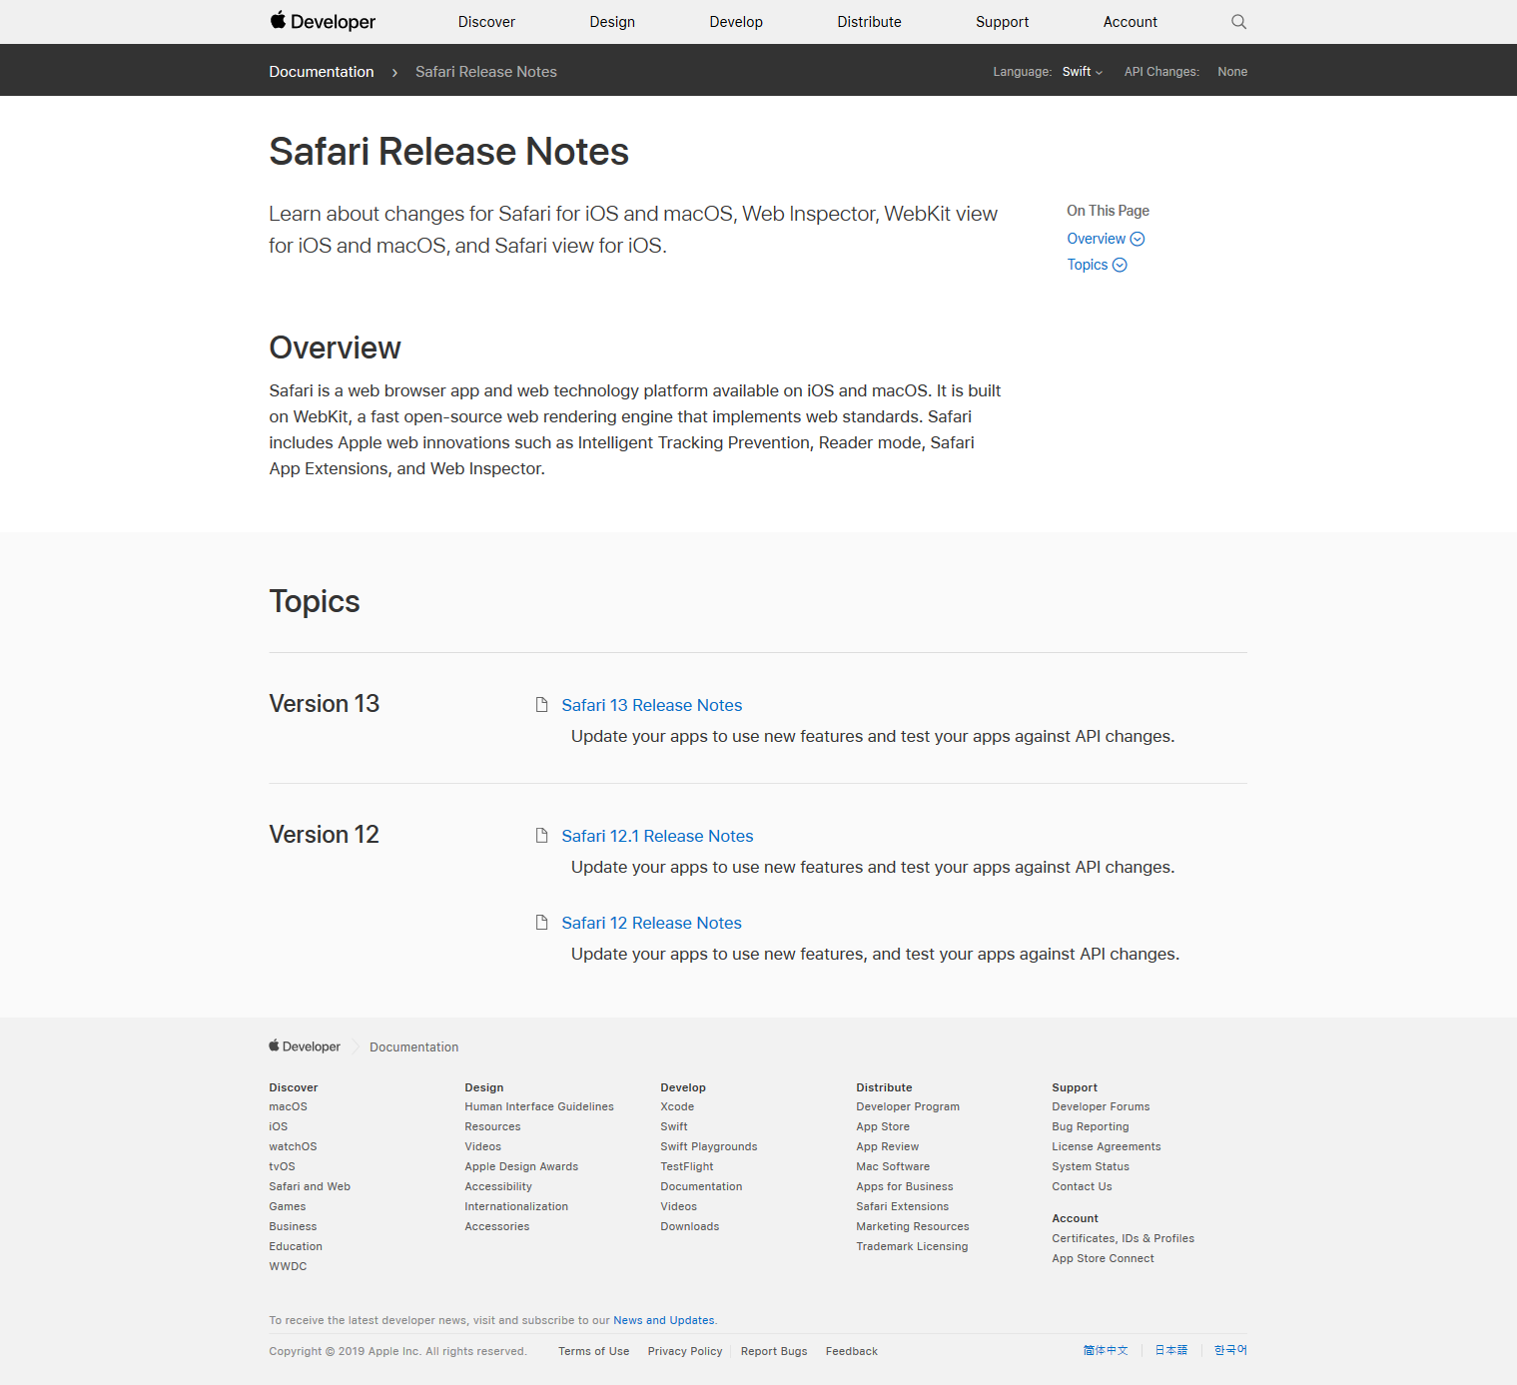

Slide 72
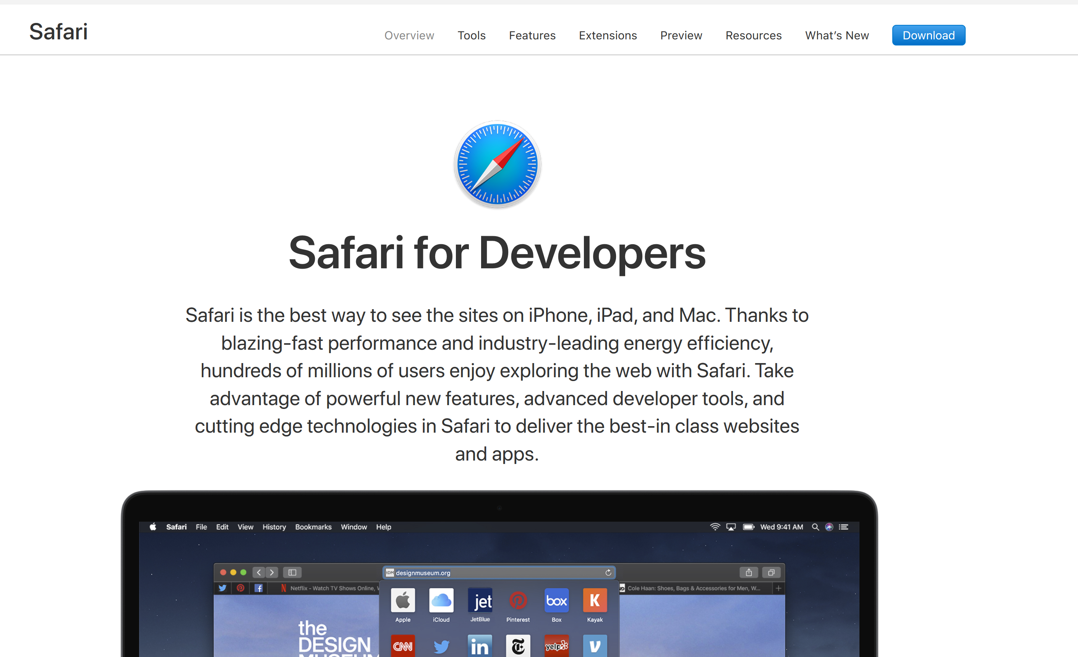

Slide 73

Final thoughts…
Notes:
Things are more complex, but I don’t view that as 100% bad – it’s a part of the platform becoming more powerful
Flip side is we need to look at what it’s like for day 1 folks. “intro to web” etc

